Slide 1
Situational Awareness
De- Escalation
Risk Management

Slide 2
Housekeeping
Please silence phones
Questions and Examples
Safe Space
Emergency Exits
Notes:
Rally point: Southeast side of the Webb Building
Image: https://static.vecteezy.com/system/resources/previews/002/301/058/original/fire-exit-emergency-green-sign-free-vector.jpg

Slide 3
Objectives
Situational Awareness
De-escalation
Personal Safety

Slide 4
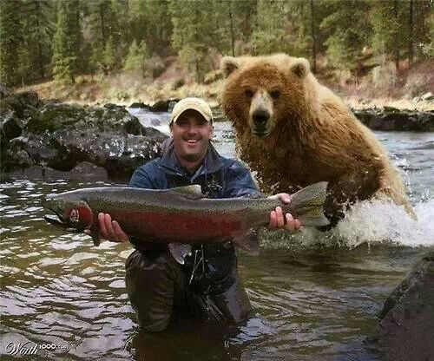
Definitions
What is Situational Awareness?
“The combining of new information with existing knowledge in working memory and the development of a composite picture of the situation along with projections of future status and subsequent decisions as to appropriate courses of action to take” (Fracker, 1991)
Notes:
Decrease words
Photo: https://www.mushroomnetworks.com/blog/situational-awareness-solutions-for-first-responders/

Slide 5
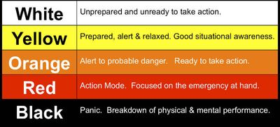
Situational Awareness: Levels
Notes:
Image: https://secureservercdn.net/198.71.233.197/g4t.9dc.myftpupload.com/wp-content/uploads/2016/04/Coopers_Levels_of_Awareness_Indicators_of_Violence.jpg

Slide 6
Principles
3 Principles of Situational Awareness
Perception
Perception of what is taking place around you
Comprehension
Processing the information that you are receiving
Prediction/Projection
Ability to estimate what will happen
Notes:
Comes from the OODA loop, when you hear something then really understand what you are seeing or hearing, example is your child or dog making a noise, comprehend and then actually do something
In active shooter situation, you typically have 3 seconds to react

Slide 7
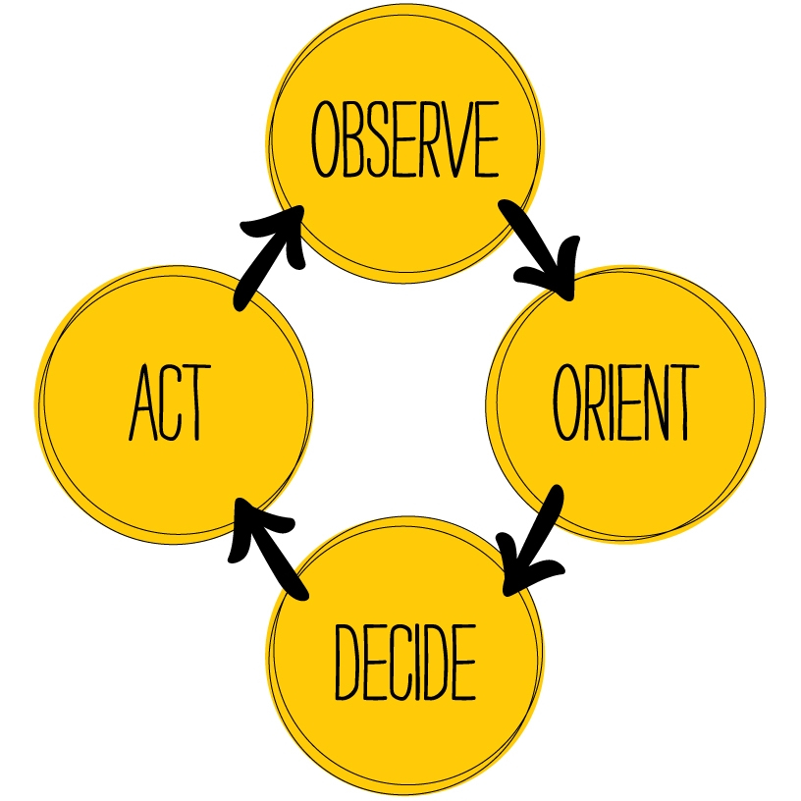
OODA Loop
OODA Loop developed by the US Air Force
Observe – What is happening?
Orient - I’ve seen this before
Decide – I know what to expect/do
Act – Decision into action
Notes:
In most situations you have a short amount of time to react, so act and decide fast. In an active shooter situation DPD states you have 3 seconds to react and decide your next steps

Slide 8
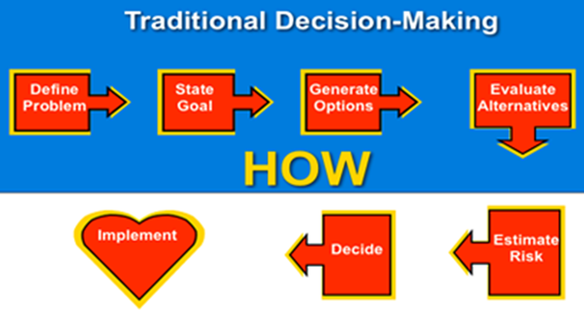
Factors effecting SA
Environmental
Weather, uncertainty, friction
Human
Education, training, physical conditioning

Slide 9
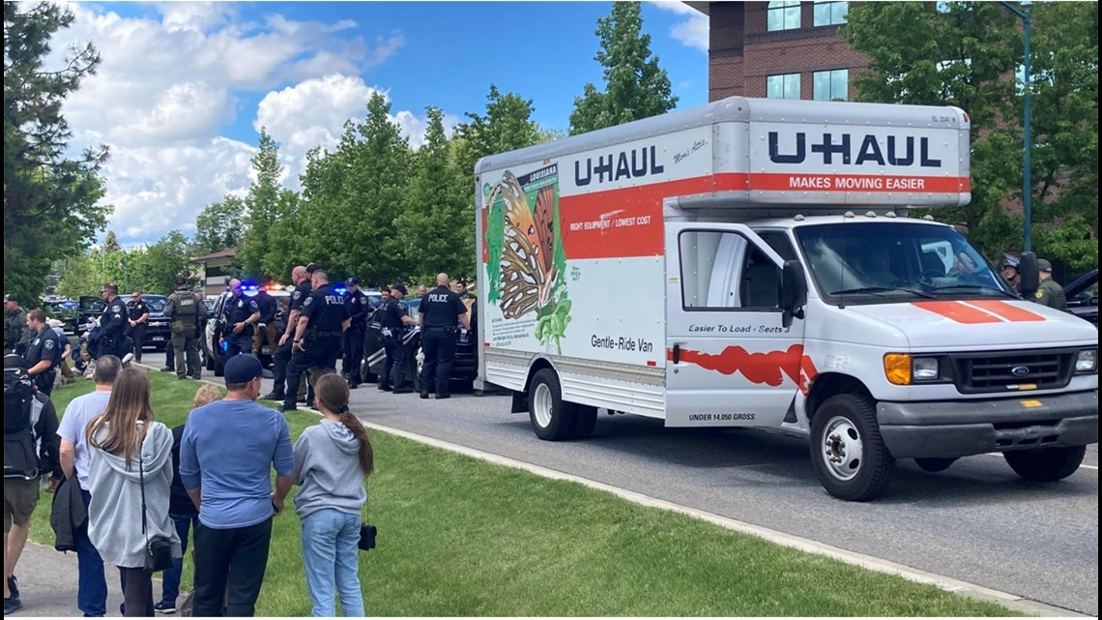
Applying SA
Situational Awareness - Idaho Pride Parade
Notes:
Seeing something and acting on it, try and find new example
https://www.politico.com/news/2022/06/12/patriot-front-arrests-idaho-pride-00039089- tipster was in a hotel parking lot, saw group of men loading into a uhual with riot gear and uniforms on, arrested outside of the pride parade area
Mention perception when it comes to stereotyping, race and implicit bias- unconscious state of mind, use concrete evidence or gut feeling and get out of the situation, studies have shown implicit bias to be linked with the predictive brain…
https://www.nature.com/articles/palcomms201786

Slide 10
The First Responder Mindset

Slide 11
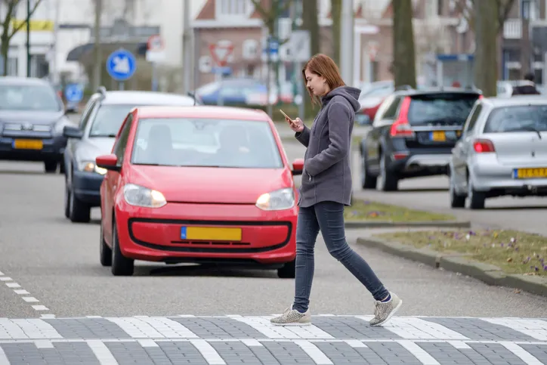
Unawareness
Loss of Situational Awareness
Taking shortcuts
Complacency
Fatigue
Being uncomfortable
Lack of training/muscle memory
Notes:
Being in a rush

Slide 12
Observe and Orient

Slide 13
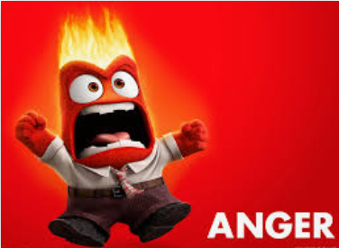
De-Escalation
Science of Anger
Feeling wronged
Stress response
Fear
Not being heard
Past experiences
Notes:
Source: https://www.mind.org.uk/information-support/types-of-mental-health-problems/anger/causes-of-anger/#:~:text=Everyone%20has%20their%20own%20triggers,being%20invalidated%20or%20treated%20unfairly

Slide 14
Roleplay
Sometimes it’s not what you say, but how you say it.
Say the following sentence with different tones:
“What are you doing here?”
In a suspicious tone
In a happy tone
In a patronizing tone
In an irritable tone

Slide 15
Stages of Escalation
What are the behavioral signs of escalation?
Exaggerated and quick movements.
Stomping feet.
Forceful speech, yelling, and screaming.
Clenched fists.
Clenched jaw.
Fighting stance.
Even becoming silent.
Notes:
Let’s talk about the specific stages of escalation.
Ask the question:
What are some signs we can see when a person starts to escalate?
Answers may include the following: Exaggerated and quick movements. Stomping their feet. Forceful speech, yelling, and screaming. Clenched fists. Clenched jaw. Fighting stance. Even becoming silent/stewing.

Slide 16
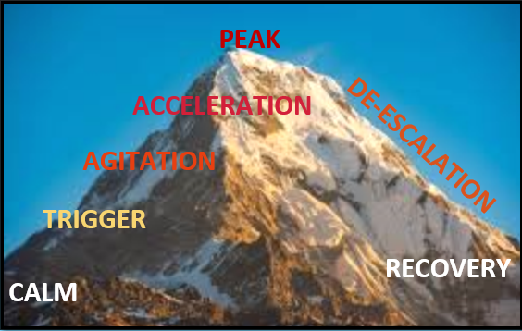
Notes:
The stages of escalation are like a mountain. Think of them as climbing and descending the mountain. At the base, everything is calm. The person is relatively calm and cooperative. Then a triggering event happens. This is something that sets the person off and they begin to escalate. Then comes agitation. The person increasingly becomes upset. It accelerates. The person is very focused on the conflict. Then it peaks. They are exhibiting severe behavior and may be out of control. Then the person de-escalates. This can be venting, and working through problem solving, or coming to an understanding. Then comes the recovery at the base on the other side of the mountain. The individual becomes cooperative and can move toward the calm baseline.
Ask the question:
What are some triggering events that may cause someone to escalate into anger or fear?
Answers may include: Mental illness, Substance abuse, Violence, Feeling of not being respected, Loss of power, Embarrassed, Not being treated justly/equitably, Physical pain.

Slide 17
De-Escalation
Learned Techniques
Reading the situation
Body language (55%)
Prepare to de-escalate
Use compassion & empathy
Do not expect to resolve
Any examples?
Notes:
Image: https://img.freepik.com/premium-photo/irritated-young-woman-with-her-arms-crossed-her-chest-looking-camera-with-skeptical-look-is-isolated-pink-background-human-facial-expressions-body-language-copying-space_137321-1700.jpg?w=2000

Slide 18
Personal Space

Slide 19
De-escalation

Slide 20
Steps to Try
Active Listening
Often the person wants to be heard
Know your role and know your goal
Recognize/Acknowledge
Summative reflection or restating concerns
Validate the emotion
Empathize
Don’t apologize for things out of your control

Slide 21
Summative Reflection
“let me be sure I understand what you’re saying. You’re feeling X, because of Y, is that right?”

Slide 22
Facilitating an Outcome
Don’t Guess and Don’t Be Afraid to Ask
Ask for clarification
Explain the why
Provide solutions when possible
If not possible, direct to appropriate resources
If, Then
Do not condone bad behavior
Reiterate their options/choices clearly
If you feel unsafe, call for assistance
Notes:
You never know what another person is going through, never assume
https://npr.brightspotcdn.com/dims4/default/faf66be/2147483647/strip/true/crop/1024x719+0+0/resize/880x618!/quality/90/?url=http%3A%2F%2Fnpr-brightspot.s3.amazonaws.com%2Flegacy%2Fsites%2Fkstx%2Ffiles%2F201808%2FMentalHealth_Flickr.jpg

Slide 23
What NOT to Do
NEVER make unattainable promises
NEVER threaten or challenge
NEVER tell someone to calm down
Increases their anger and creates barrier
NEVER lose your situational awareness
Remain in a vigilant position
Notes:
When in doubt, remove yourself from the situation
Always yourself and the door, barriers are important for protection but also can create more hostility

Slide 24
Exercise: Discuss with a Partner
Instead of saying…
“Calm Down”
“I can’t help you”
“I know how you feel”
Instead of….
Standing directly in front of the person
Gesturing or moving quickly
Faking a smile
Notes:
https://www.cisa.gov/sites/default/files/2022-11/De-Escalation_Final%20508%20%2809.21.21%29.pdf
Standing rigidly directly in front of the person Keeping a relaxed and alert stance off to the side of the person Pointing your finger Keeping your hands down, open, and visible at all times Excessive gesturing or pacing Using slow, deliberate movements Faking a smile Maintaining a neutral and attentive facial expression
“Calm down.” “I can see that you are upset...” “I can’t help you.” “I want to help, what can I do?” “I know how you feel.” “I understand that you feel...” “Come with me.” “May I speak with you?”

Slide 25
All people want to be:
Treated with dignity and respect
Asked rather than told to do something
Told why they are being asked
Offered options rather than threats
Given a second chance
~Dr. George Thompson

Slide 26
Personal Safety
Be Prepared!
Plan your day
Share your itinerary
Know your start and end locations
Workplace Safety
See Something, Say Something
Secure personal items
Respect Secured Areas
On Street Safety
Carry few bags
Keep hands free
Don’t inhibit situational awareness with loud music or noise canceling headphones
Stay aware of those near you or approaching you
Don’t display identifying information

Slide 27
Practice Safety
Trust your instincts – If it “feels” wrong, it probably is!
Use good judgment – Would you send your favorite person there?
Don’t become complacent – Don’t lose situational awareness
Notes:
Change language so it isn’t as scary for downtown.
Add stats for types of violent crime
Out of control so how do we manage

Slide 28
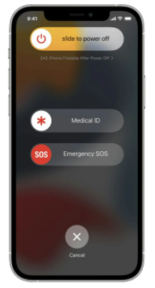
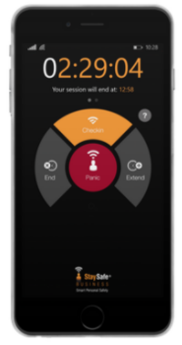
Smart Phones
EMERGENCY NOTIFICATION
Notes:
Android- quickly tapping the power button 5 times

Slide 29
Unauthorized Visitors
Be Vigilant
No piggybacking
Make sure elevator bank doors are closed
If someone looks lost, ask and assist
Report the visitor to a supervisor or call security if that person should not be on the floor

Slide 30
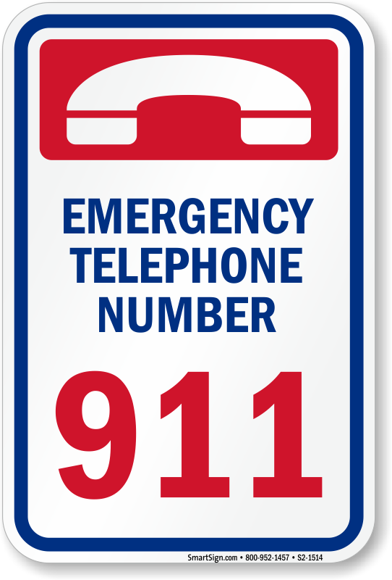
See Something
Say Something!
When in doubt, report
Add any emergency numbers to your phone
Notes:
Photo: https://www.mypoolsigns.com/img/lg/S/emergency-telephone-number-sign-s2-1514.png

Slide 31
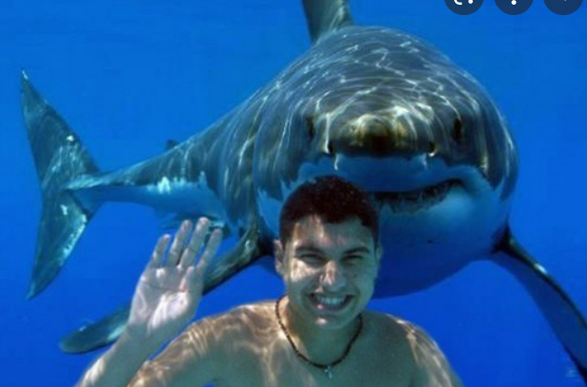
Any Questions?
Thank you!
Devin Clark
720-698-0438
Devin.clark@denvergov.org
Bailey Shaw
720-556-4292
Bailey.shaw@denvergov.org

