Slide 1
CUSTOMIZABLE INFOGRAPHIC
HOW TO USE THIS TOOL
Step 1: Identify the audience and the theme/focus for the infographic or fact sheet
You may be most interested in sharing data collected about youth access or smoke-free places with your city council. Gather the most pertinent data and findings to educate your audience and communicate the issue. Be mindful of how much data you’re putting on a page; more is not always better.
Step 2: Consider how you can visualize the information using the icons and elements in this document
How can you utilize the icons, graphical elements, graphs, etc. to illustrate the information?
Step 3: Design your infographic or fact sheet
Use the blank slide (slide 2) as your template and copy & paste the elements from slides 3 through 5 to build your fact sheet. Be sure to keep some “white space” between the different elements so the information is easy to read and comprehend.
Step 4: Save and share!
Delete all slides in the file except for slide 2 (your infographic) and save with a new file name. Share the document with relevant stakeholders and supporters to educate around the issue you’ve highlighted.
If you need assistance, please contact TA@SE2Communications.com

Slide 2
REPLACE WITH YOUR LOGO

Slide 3
FONTS & COLORS
HEADER
HEADER
HEADER 2
HEADER 2
Header 3
Header 3
Use this for body copy and details.
Use this for body copy and details.
Header 3
HEADER
Body copy about the subject matter can go here to illustrate the issue.
HEADER 2
Header 3
Use this for body copy and details.
Pro Tip: Use these colors for bar graphs, statistics, and headers. Select “more colors”, “custom”, RGB
Yellow
234 / 230 / 41
Orange
248 / 156 / 49
Blue
145 / 214 / 230
Red
242 / 114 / 77
Green
162 / 206 / 98

Slide 4














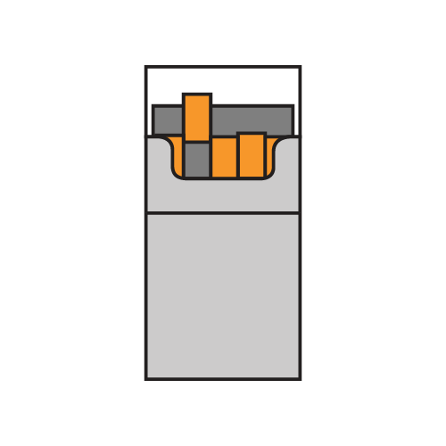



























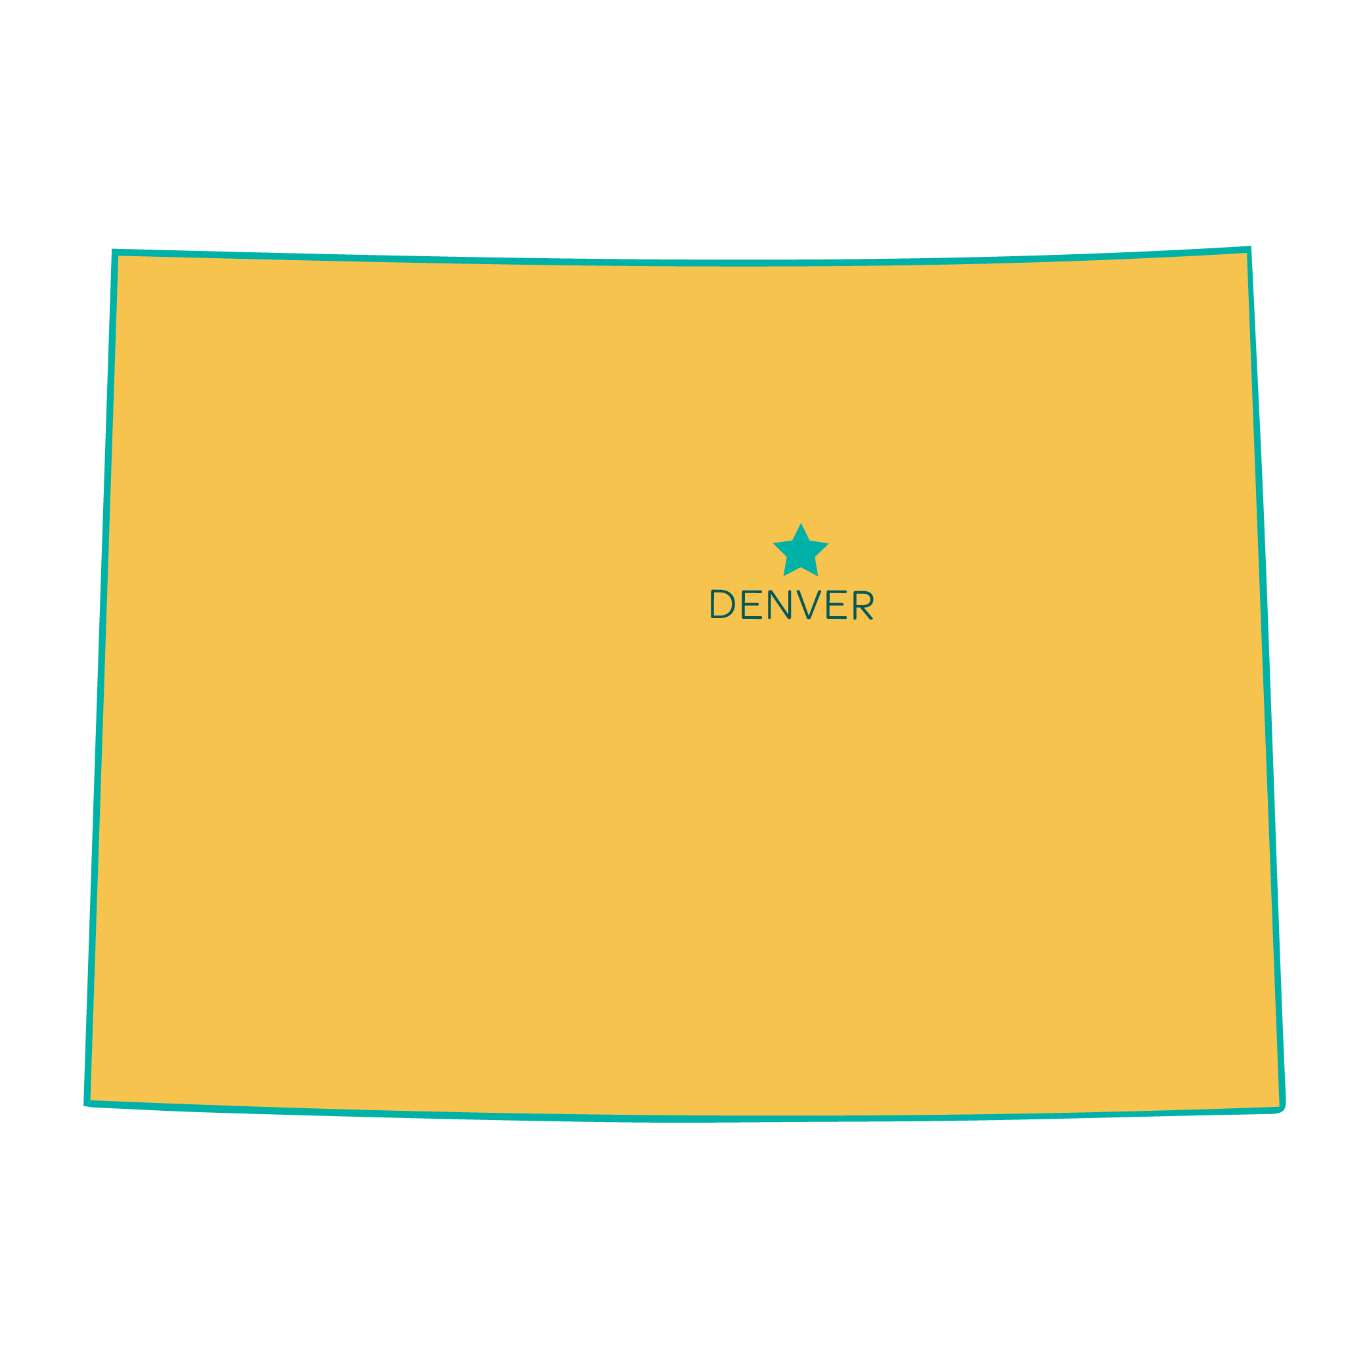




PEOPLE ICONS
PRODUCT ICONS
PLACE ICONS
POLICY-RELATED ICONS
MISCELANEOUS ICONS

Slide 5


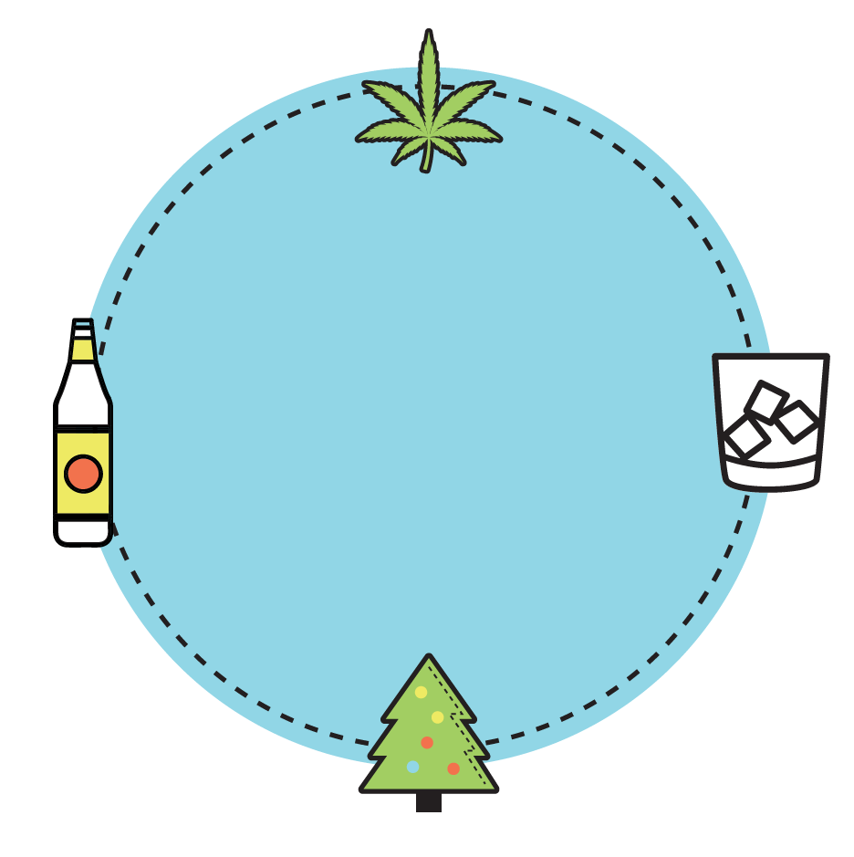


LINES
Pro Tip: Illustrate other data points by replacing product images with other icons or only use the bars
DATA VISUALIZATION
67%
Body copy can go here to provide information about the statistic.
X%
X%
X%
3 OUT OF 4
X%
Body copy about the statistic goes here.
Pro Tip: To create a grayscale version of any icon, create a copy of the icon, click the “format tab”, click “color”, then select the grayscale option under “recolor”.
CALL-OUT SHAPES

