Slide 1
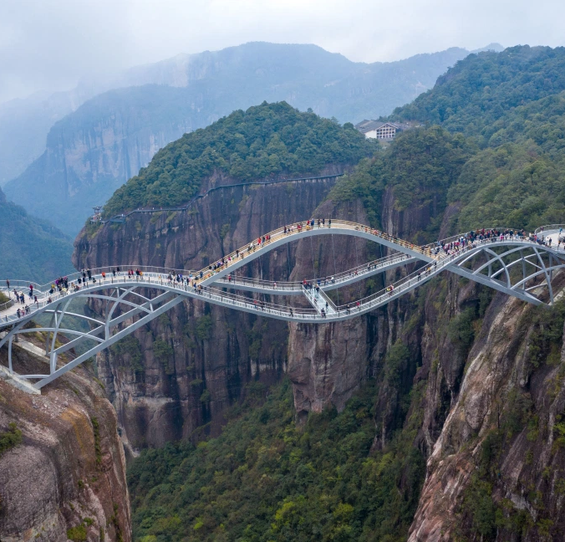

Bridge Assessment

Slide 2
After COVID disruption how do we get back on track?
Does the Implementation Plan still align with community needs?
  Reconnecting with community
  Reconnecting with stakeholders
  Evaluating efforts, activities, outcomes
Planning for the next two fiscal years and beyond…
  How can we align and streamline the planning, reporting, and evaluation-related processes

Slide 3
Considered Options
Option 1: Full TFCP
Performed by all the grantees
Option 2: Bridge Assessment
Scaled assessment to determine the next action steps
Bridge Assessment
Scalable based on Grantee stage of activity and effort; communities had different levels of staff/ resources diverted to COVID efforts and many are still struggling with reduced capacity
Examines grantees’ progress, and identifies challenges and barriers, and helps grantees build a roadmap to continue, modify or redirect current efforts
Less disruptive and intensive compared to full TFCP

Slide 4
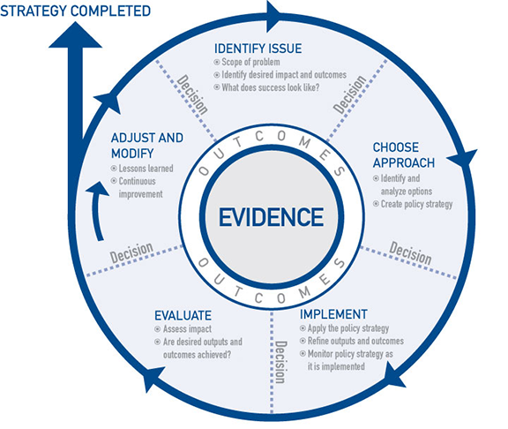
Bridge assessment focuses on the
Evaluate, Adjust and Modify phases of the Evidence Wheel

Slide 5
Bridge Assessment – Strategy Grantees

Slide 6
EXAMPLE:
Strategy 1.1: Promote and assist in the implementation of comprehensive Tobacco Free School policies.

Slide 7
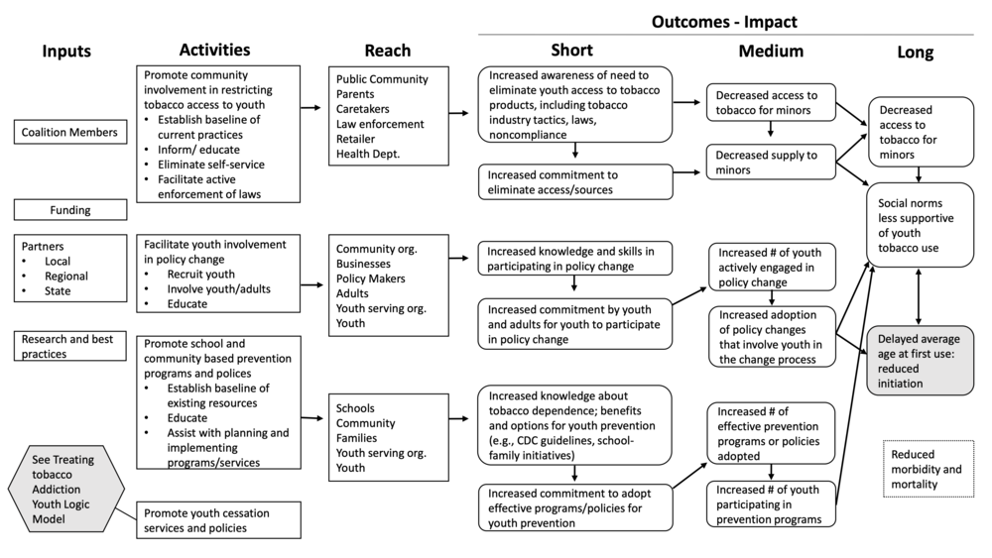
Examine your logic model. Use your QPR data (CEPEG can provide an abbreviated version) to assess progress. Do you need additional data?

Slide 8
QPR FRAMEWORK
PS1 | Preparation | Identify and engage strategic partners
PS2 |  | Investigate and analyze current situation and potential intervention/program/policy solution
PS3 |  | Provide assistance, education and other resources to community/strategic partners
PS4 | Initiation | Mobilize community and supporters
PS5 |  | Assess decision maker support
PS6 |  | Review, revise, propose intervention/program/policy
PS7 | Action | Prepare for implementation and enforcement
PS8 |  | Implement/assist with implementation of intervention/program/policy
PS9 |  | Monitor intervention/program/policy adherence/enforcement/outcomes

Slide 10
Strategy 1.1 - Promote and assist in the implementation of comprehensive Tobacco Free School policies
Category | Based on your logic model, please list inputs / activities / reach / target populations. | Are these essential for the work to move forward? | Are these already established / accomplished / in place? | If yes – are they sustainable? | If not – it is possible for you to establish/ accomplish / put these in place, given existing resources? | Please, briefly describe the additional work that still needs to be done to establish / accomplish / put in place /sustain this? | Please provide brief additional information or explanation to help us better understand the critical factors that affect your work including current environment or contextual issues. (optional) | TA feedback | POC feedback | Recommended action
 |  | Answer key: NO / SOMEWHAT (on the scale of 1-5, where 1 is closest to NO and 5 is closest to YES) / YES
Input
Activities
Reach
Populations
Final STEPP recommendation made after grantee and STEPP meeting (please highlight applicable): Continue with the current IP Revise the current IP Conduct a new needs assessment and create a new IP

Slide 11
Strategy 1.1 - Promote and assist in the implementation of comprehensive Tobacco Free School policies
Category | Based on your logic model, please list inputs / activities / reach / target populations. | Are these essential for the work to move forward? | Are these already established / accomplished / in place? | If yes – are they sustainable? | If not – it is possible for you to establish/ accomplish / put these in place, given existing resources? | Please, briefly describe the additional work that still needs to be done to establish / accomplish / put in place /sustain this? | Please provide brief additional information or explanation to help us better understand the critical factors that affect your work including current environment or contextual issues. (optional) | TA feedback | POC feedback | Recommended action
 |  | Answer key: NO / SOMEWHAT (on the scale of 1-5, where 1 is closest to NO and 5 is closest to YES) / YES
Inputs | Tobacco Free Signs, surveys, small food incentives, flyers | 4 | 2 | 5 | 5 | Signage distributed and hung at all middle and high schools would be great accomplishment- need administrative support to agree and facilities support to make sure they are hung. | School Administrators have limited understanding about current policies and the level of their implementation.
Activities | Presentations, family wellness nights, staff development sessions, meeting with administrators, | 4 | 3 | 3 | 3 | Wellness nights or sustained engagement sessions would enable more authentic connections and better support from schools. | Schools capacity and priorities vary.
Reach | School /school district administrators, parents, student | 4 | 2 | 3 | 3 | Reach could also be expanded to include more engaged parents or youth.
Populations
Final STEPP recommendation made after grantee and STEPP meeting (please highlight applicable): Continue with the current IP Revise the current IP Conduct a new needs assessment and create a new IP

Slide 12
Bridge Assessment – Foundational Grantees

Slide 13
Setting:
FA 1 | Benchmarks Will be prepopulated | Last reported scores Will be prepopulated | Briefly describe what still needs to happen to achieve this benchmark. | Based on your experience to date, is this an achievable benchmark in this grant cycle? yes/maybe/no | If your previous answer was maybe or no, please provide a brief explanation. | POC feedback
Identify and engage strategic partners
Investigate and analyze current situation and potential intervention/ program/ policy solution
Provide assistance, education and other resources to community/ strategic partners
Mobilize community and supporters
Assess decision-maker support
Final STEPP recommendation made after grantee and STEPP meeting (please highlight applicable): Continue with the current IP Revise the current IP Conduct a new needs assessment and create a new IP

Slide 14
Setting:
FA 1 | Benchmarks Will be prepopulated | Last reported scores Will be prepopulated | Briefly describe what still needs to happen to achieve this benchmark. | Based on your experience to date, is this an achievable benchmark in this grant cycle? yes/maybe/no | If your previous answer was maybe or no, please provide a brief explanation. | POC feedback
Identify and engage strategic partners | Identification of stakeholders and their values/positions, develop a Taskforce. | 6
Investigate and analyze current situation and potential intervention/ program/ policy solution | The task force has analyzed the current situation, final analysis presented to stuff. | 5
Provide assistance, education and other resources to community/ strategic partners | Plans for implementation of training to the community for education, workshop finalized. | 4
Mobilize community and supporters | Target audiences identified, training delivered to identified audiences. | 2
Assess decision-maker support
Final STEPP recommendation made after grantee and STEPP meeting (please highlight applicable): Continue with the current IP Revise the current IP Conduct a new needs assessment and create a new IP

Slide 15
POC and TA input
POCs, TA and CEPEG will review results of the bridge assessment in collaboration with grantees
Revisions to the current IMP should be discussed (or plans for a new, full or partial TFCP)
POCs and grantees will identify next steps
  Updates to the IMP
  Timeline for implementation

Slide 16
Final STEPP recommendation made after grantee and STEPP meeting
- Continue with the current IP
Or
- Revise the current IP
Or
- Conduct a new needs assessment and create a new IP

Slide 17
New IP template

Slide 19
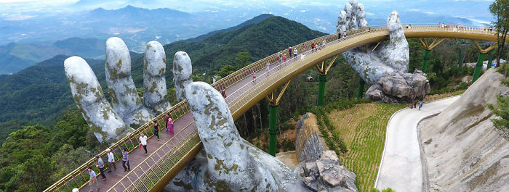
Questions?

