Slide 1

HB20-1001
Concerning Nicotine Product Regulations
What It Is the State Law and What Happens Now

Slide 2
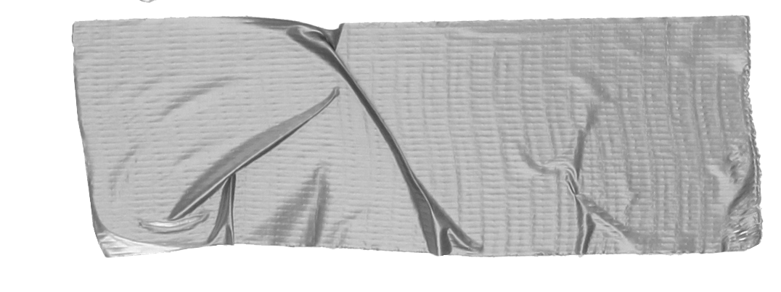

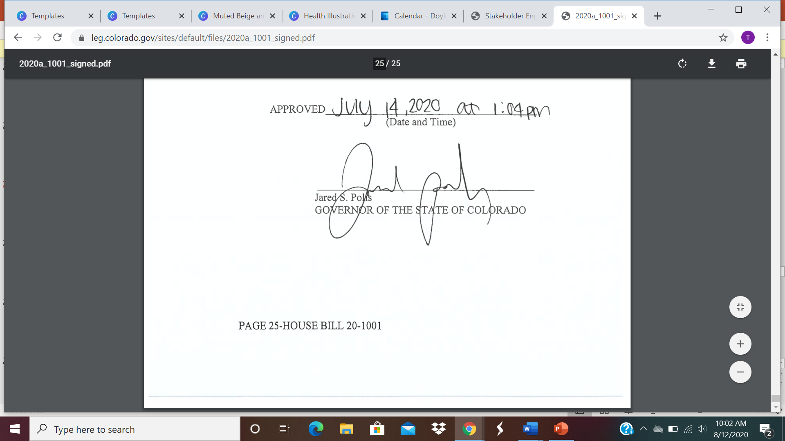
A state license is required for all cigarettes, tobacco products or nicotine product retailers beginning
July 1, 2021.

Slide 3
Department of Revenue (DOR)
and Rule Making
Legislatures set broad policy mandates by passing statutes then agencies create the more detailed regulations through rule making.
Notes:
Parts of the new law are still to be determined and will be ruled upon by the Department of Revenue, Division of Alcohol and Tobacco (Division).

Slide 4
What does a license cost?
Not to exceed $400
Large-operators may qualify for a special license to be determined by the Division.
May increase up to $600 if statewide compliance rate drops below 90%

Slide 5
Key Provisions
Valid for one year
Non-transferrable
Must be displayed at all times
Requires coordination between state and local authority for:
Compliance checks and complaint resolutions.
Annual renewal date.
Sharing of information.
Suspension and revocation of local law results in same for state law.

Slide 6

Key Provisions
Minimum Legal Sales Age (MLSA)
Raised from 18 to 21.
Notes:
Municipalities and counties may not institute a law that reduces the minimum legal sales age below 21.

Slide 7

Key Provisions
Minor in Possession Removed
MIP
Notes:
The penalty for possession of cigarettes and tobacco products by persons under 18 years of age previously in Colorado’s Teen Tobacco Use Prevention Act (TTUPA)[i] has been removed and amended with language that prohibits the sale of cigarettes and tobacco products to persons under 21 years of age

Slide 8
Under 21? No entry into tobacco shops including vape shops and cigar bars.
No Entry if
Under 21!

Slide 9

Key Provisions
Check ID of anyone appearing to be under 50 years of age.

Slide 10
Vending machines allowed in licensed gaming establishments only.
Must have sign on machine saying 21 and older.

Slide 11
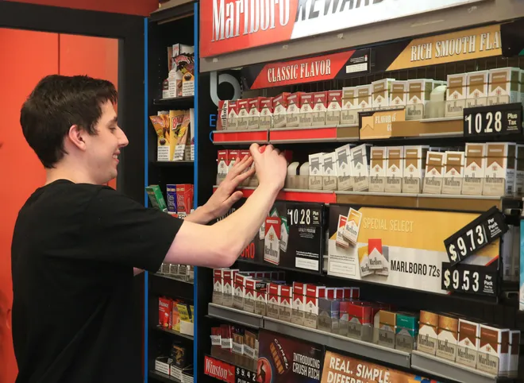
Employees must be 18 to sell and handle cigarettes, tobacco and nicotine products.
Clerk Age Restrictions

Slide 12
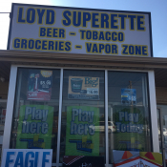
Retailer Distance from Schools
After July 1, 2021, a state license will not be approved for any cigarette, tobacco product or nicotine product retailer located within 500’ of a school.
Local jurisdictions can enact ordinances that:
exempt certain types of schools from the 500’ distance requirement
allow distances less than 500’
allow greater than 500’ from a school and other facilities
Notes:
This distance requirement does not apply to businesses that sold cigarettes, tobacco products or nicotine products prior to July 1, 2021; This distance requiremThis distance requirement does not apply to businesses that sold cigarettes, tobacco products or nicotine products prior to July 1, 2021;ent does not apply to businesses that sold cigarettes, tobacco products or nicotine products prior to July 1, 2021;
allow greater than 500’ from a school and other facilities

Slide 13
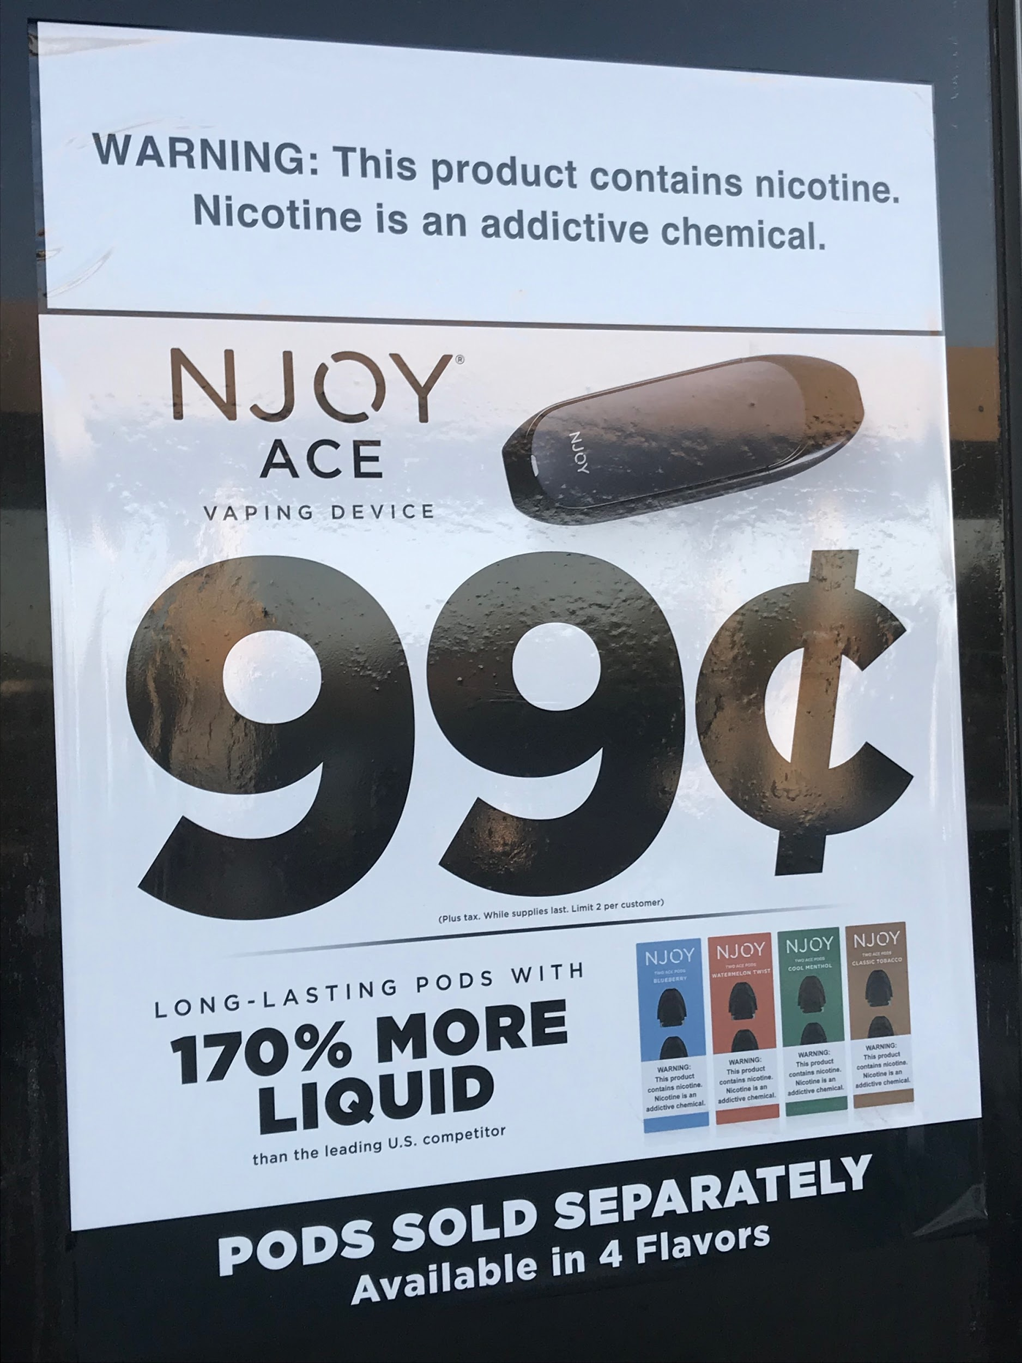
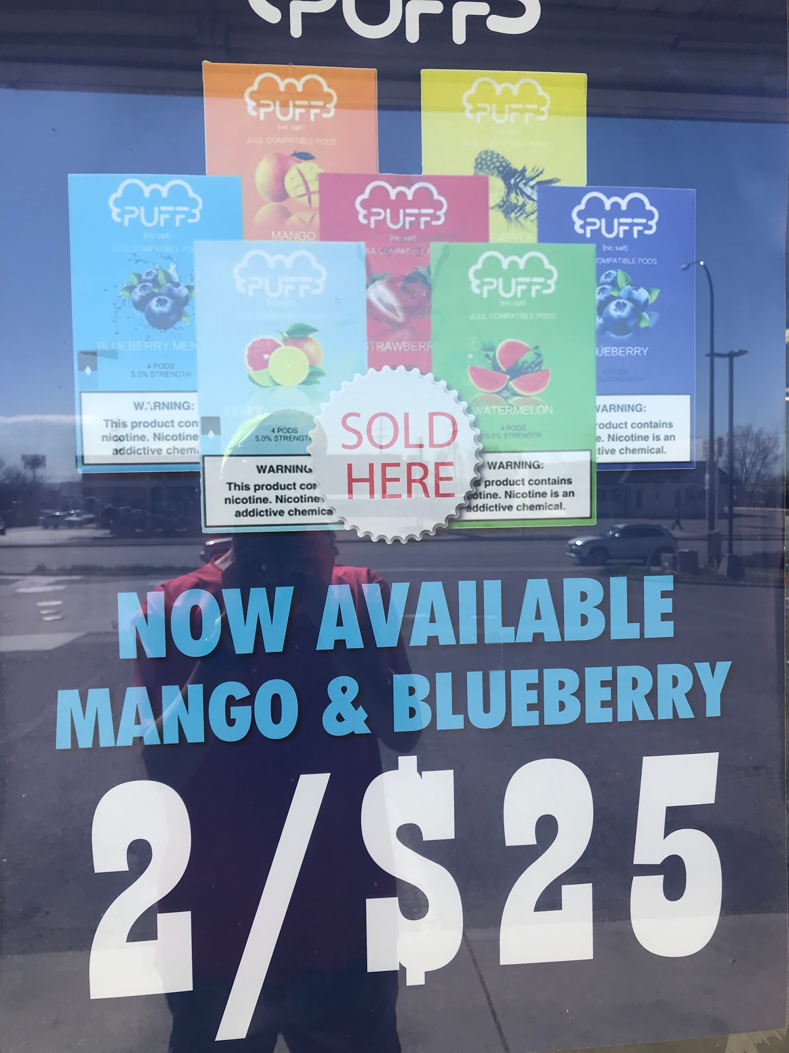
Advertising
Retailers who sell electronic smoking devices (ESDs) cannot advertise or promote ESDs in a way that is visible from outside the store.

Slide 14

Shipment and Delivery
Direct shipment of cigarettes, tobacco products or nicotine products is not allowed in Colorado except for cigars and pipe tobacco to persons over 21.
Direct delivery of cigarettes, tobacco products or nicotine products is by state licensed retailers to consumers is allowed if the delivery is not to another retailer and ID is checked.
Notes:
The Division will further define product delivery requirements and product delivery permits.

Slide 15
County Powers
Boards of County Commissioners are authorized to license or otherwise regulate the sale of cigarettes, tobacco products or nicotine products to persons under 21 years of age.

Slide 16
Contingent upon fees collected by the state, two compliance checks will be conducted annually at each licensed location.
If adequate fees are not collected the number of annual compliance checks will be determined by federal law.
Compliance check violations require a re-check of the retailer for compliance within three to six months.
Compliance
Recheck for Violations
The Division will maintain and publish on the Department of Revenue’s website the business names and addresses of state licensed retailers.

Slide 17
Retailer Penalties - Sale of cigarettes, tobacco products or nicotine products to persons under 21
1st violation within 24 mos. | $250-500
2nd violation within 24 mos. | $500-750 and 7 day suspension of sales
3rd violation within 24 mos. | $750-1000 and 30 day suspension of sales
4th violation within 24 mos. | $1,000-15,000 and up to 3 year suspension of sales

Slide 18
Contact your Colorado School of Public Health Technical Assistance Provider

