Slide 1
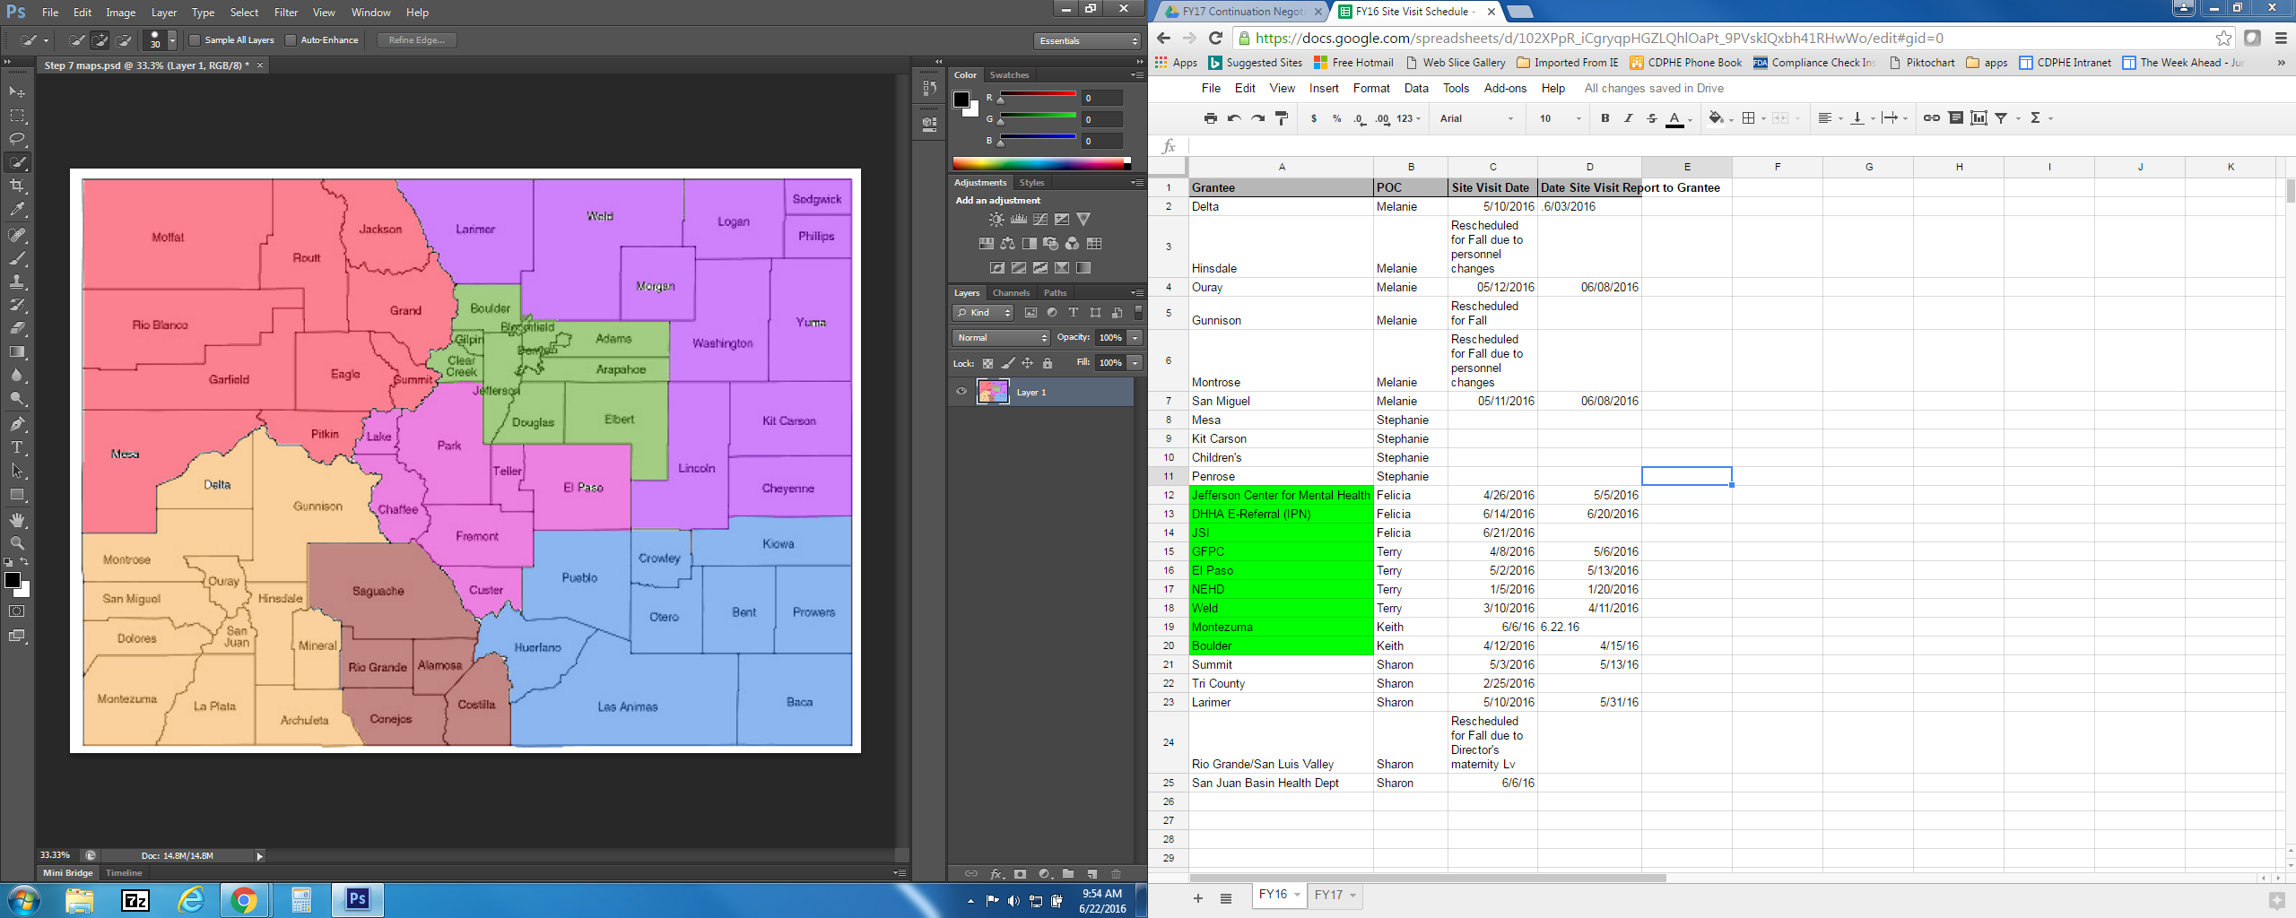
Colorado Tobacco Community Initiatives Grantee Advisory Council
Regional Map
Jan Moraczewski
Risa Turetsky
Northeast
Northwest
Vacant
Donna Viverette
North Central
Dacia Hudson
South Central
Kristi Hillis
Katie Smith
San Luis
Mike Mustain
South – Southeast
West– Southwest
One (1) Representative from each Region except for North Central will have Two (2) Representatives

